Slide 1
English 10-Unit 5:
TECHNOLOGY AND YOU
PART E :
LANGUAGE FOCUS

Slide 2
1.PRONUNCIATION:
* Listen and repeat:
/u/
/u:/
put
foot
food
fruit
pull
look
school
June
full
cook
tooth
afternoon

Slide 3
*PRACTICE THESE SENTENCES
1. Could you tell me where you’ve put my book?
2. Your bookshelf is full of books.
3. Look! The boy is looking at your book.
4. Miss June is looking at the Moon.
5. Both your shoes and your boots are dirty.
6. Miss Moon went to school this afternoon.

Slide 4

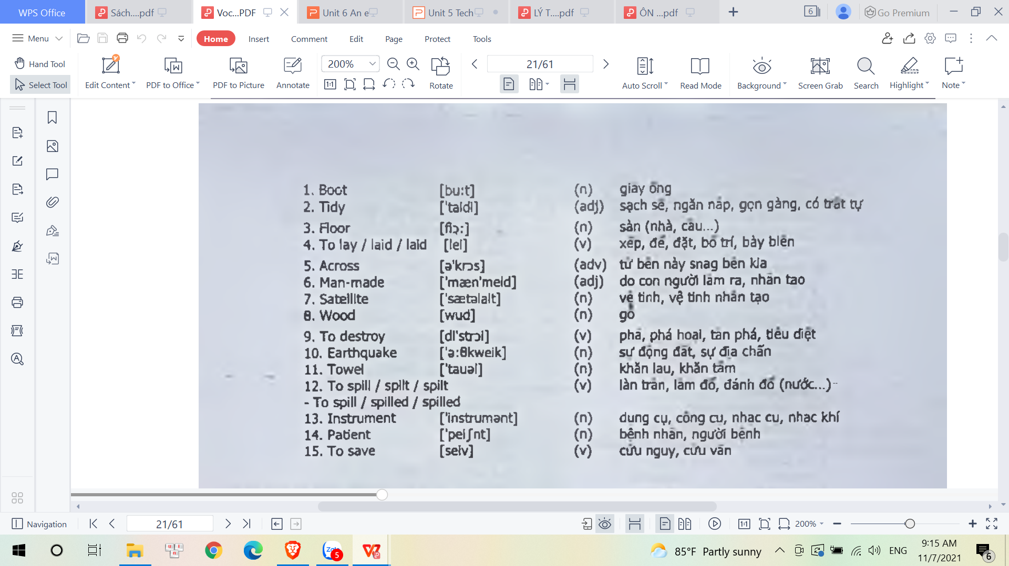
VOCABULARY
sang

Slide 5


Where are my keys?
Mary has lost her keys.
Mary

Slide 6
a. PRESENT PERFECT
2.GRAMMAR:
Form
S + have/has + V_{3/ed} + O
Ex. Mary has lost her keys.
=> Hành động xảy ra trong quá khứ, nhưng không xác định rõ thời gian.

Slide 7

Present perfect. (Hiện tại hoàn thành)
Form:
(+) S + have/has + V_{3/d/ed} + O + …
(-) S + have/has + NOT + V_{3/d/ed} + O+ …
(?) Have/has + S + V_{3/d/ed} + O + …?
W/h + have/has + S + V_{3/d/ed} + O + …?
Note:
I/You/We/They/S_{số nhiều} have
He/She/It/S_{số ít} has
Động từ bất quy tắc (Irregular verbs) go-went-gone; have-had-had; sing-sang-sung … (học thuộc bảng động từ bất quy tắc)
Động từ có quy tắc (Regular verbs)

Slide 8
*Quy tắc thêm “d/ed*
- hầu hết chỉ cần thêm “ed”. (looked, watched, happened,…)
- smile → smiled, move → moved (tận cùng “e” → chỉ cần thêm “d”)
- stop → stopped , hug → hugged , plan → planned
(tận cùng là nguyên âm giữa 2 phụ âm → gấp đôi phụ âm cuối → thêm “ed”)
- stay → stayed , play → played , allow → allowed , follow → followed
(phụ âm cuối là x, w, h, trước “y” là nguyên âm → thêm “ed”)
- try → tried, deny → denied, carry → carried, hurry → hurried
(Trước “y” là phụ âm → đổi “y” thành “i” rồi thêm “ed”

Slide 9
Signal words (Từ nhận biết)
for so far up to now yet since recently up to present just ever lately until now already

Slide 10


Usage & Examples.
Usages (Cách dùng) | Examples
a. Diễn tả hành động xảy ra trong quá khứ nhưng không rõ thời gian hoặc việc vừa mới xảy ra. b. Diễn tả hành động xảy ra trong quá khứ nhưng để lại dấu hiệu hoặc hậu quả ở hiện tại. c. Diễn tả những trải nghiệm. d. Diễn tả những hành động xảy ra trong quá khứ nhưng kéo dài đến hiện tại và vẫn còn có khả năng sẽ tiếp diễn trong tương lai. | a. We have just returned from our holidays. Apple has recently designed a new kind of the lines of smartphones. b. I am tired now because I have run for 3 hours. c. I have eaten at that restaurant many times. d. Jane has worked in the bank for five years.

Slide 11
*PRACTICE
Unit 5 TECHNOLOGY AND YOU - LANGUAGE FOCUS
a.Exercise 1:
Quang comes to Tan’s house on his invitation and Quang sees that
the door is open.
-Tan has opened the door.
2.the TV is on.
-Tan / He has turned / switched on the TV.
3.the house is tidy.
-Tan / He has tidied the house.
4.the floor is clean.
-Tan / He has cleaned the floor.
5.the lights are on.
-Tan / He has turned on the light.
6.two bottles of water are laid on the table.
-Tan / He has laid two bottles of water on the table.

Slide 12
Present perfect passive:
S + have/has + PP + O
S’ + have/has + been + PP + (by + O’)

Slide 13
b.THE PRESENT PERFECT PASSIVE
Unit 5 TECHNOLOGY AND YOU - LANGUAGE FOCUS
2.GRAMMAR:
Form
S + have/has + been + V_{3/ed} + (by O)
EX: They have built a new bridge across the river
A new bridge has been built across the river.

Slide 14

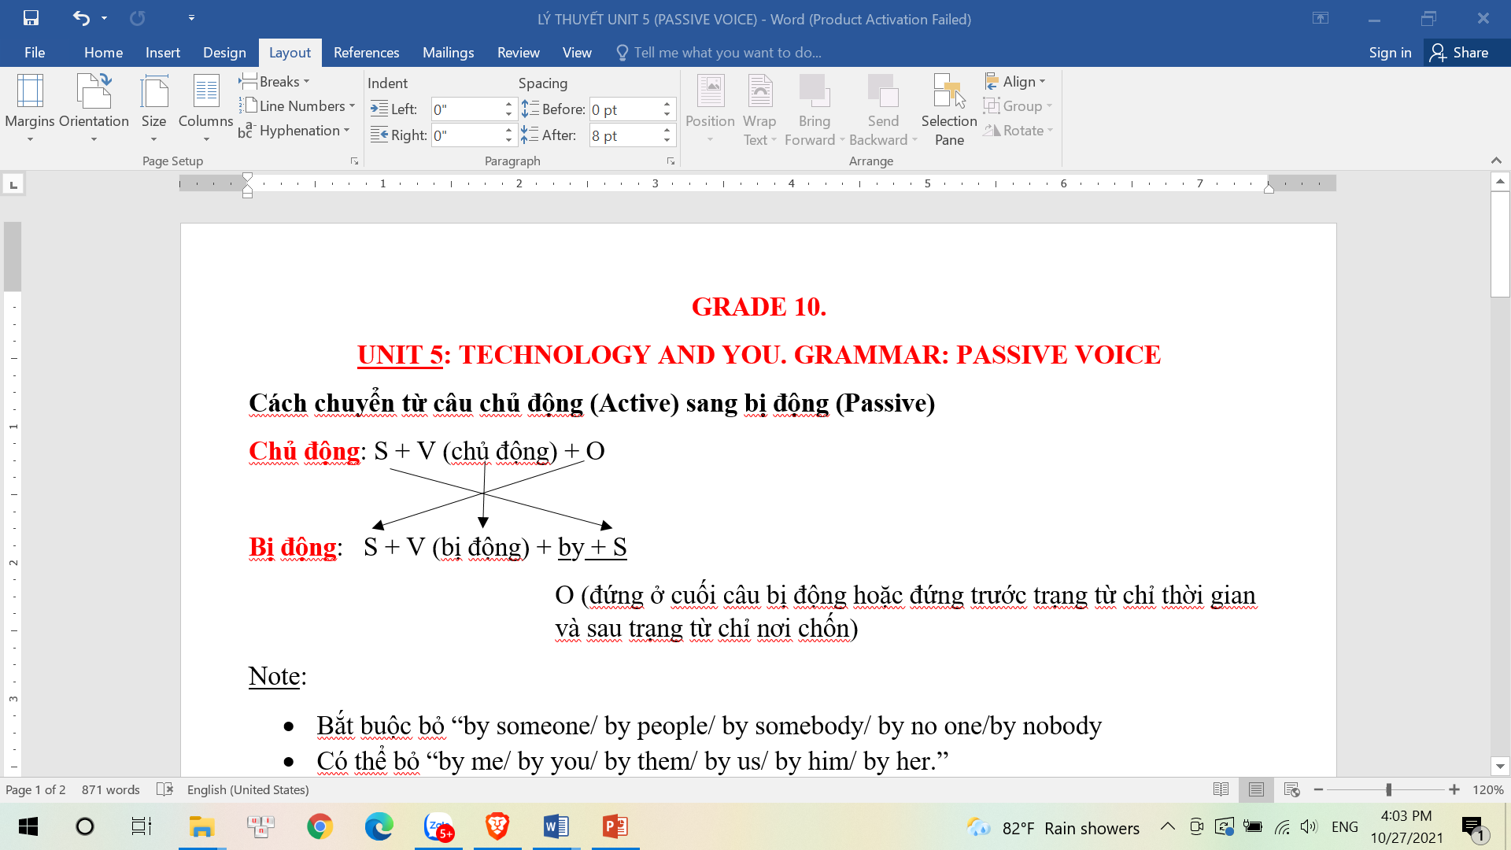
Cách chuyển từ câu chủ động (Active)
sang bị động (Passive)

Slide 15
BẢNG CHIA CHỦ ĐỘNG – BỊ ĐỘNG

Slide 16
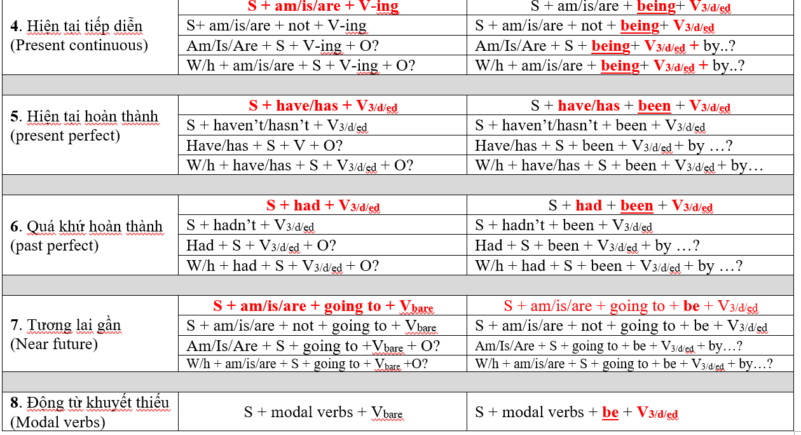

Slide 17
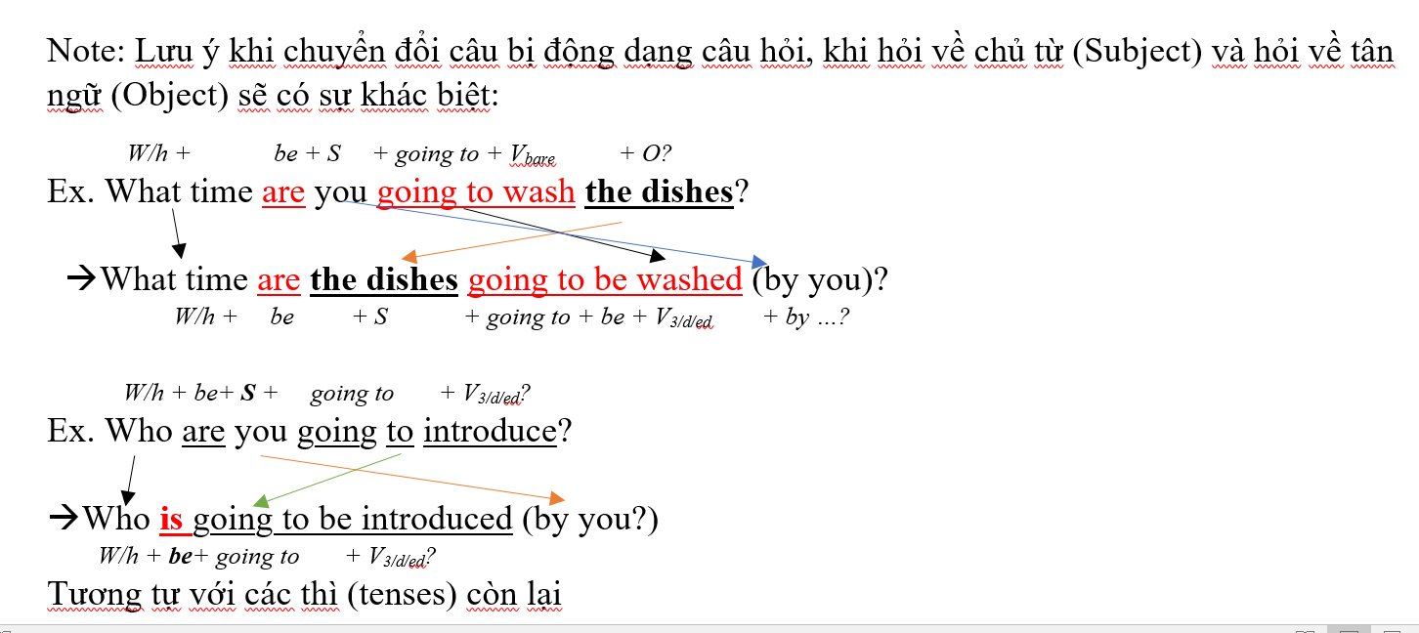

Slide 18
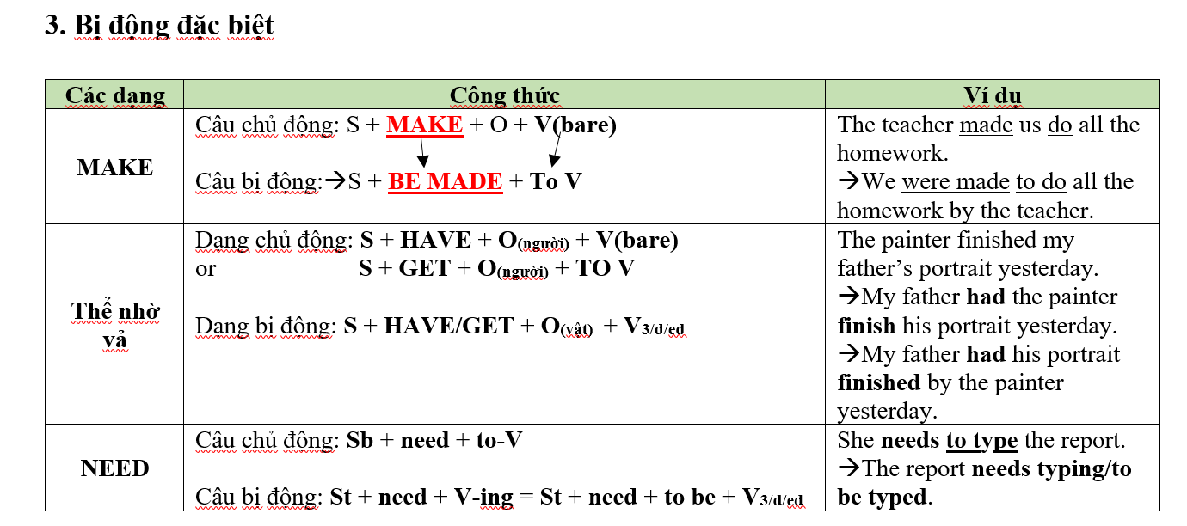

Slide 19
*Exercise 2: Build sentences after the model
1. a new hospital for children / build/ in our city
-A new hospital for children has been built in our city.
2.another man-made satellite / send up / into space
-Another man-made satellite has been sent up into space.
3. More and more trees / cut down / for wood / by farmer
-More and more trees have been cut down for woods by farmer.
4. thousands of animals / kill / in the forest fire
-Thousands of animals have been killed in the forest fire.
5. about one hundred buildings and houses / destroy / in the earthquake
-About one hundred buildings and houses have been
destroyed in the earthquake.

Slide 20
*Exercise 2: Build sentences after the model
6. more than 50 films / show / in Hanoi / since June
-More than 50 films have been shown in Hanoi since June.
7. their hands / wash and dry / on a towel
-Their hands have been washed and dried on a towel.
8. another book / read / by the students
-Another book has been read by the students.
9. some ink / spill / on the carpet
-Some ink has been spilt on the carpet.
10. she / show / how to do it
-She has been shown how to do it.

Slide 21

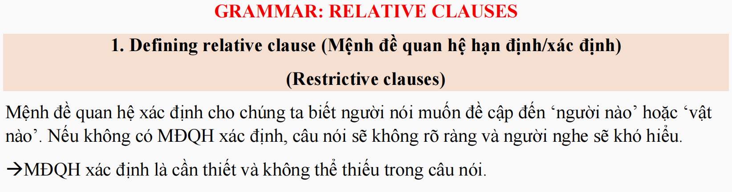
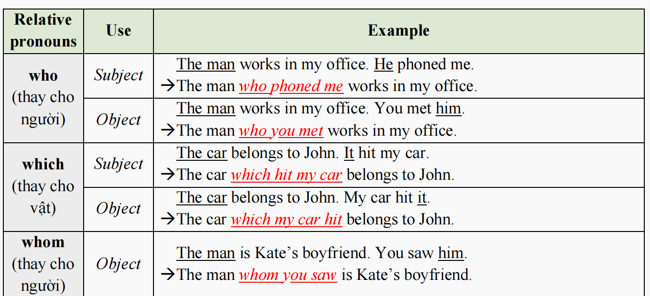

Slide 22
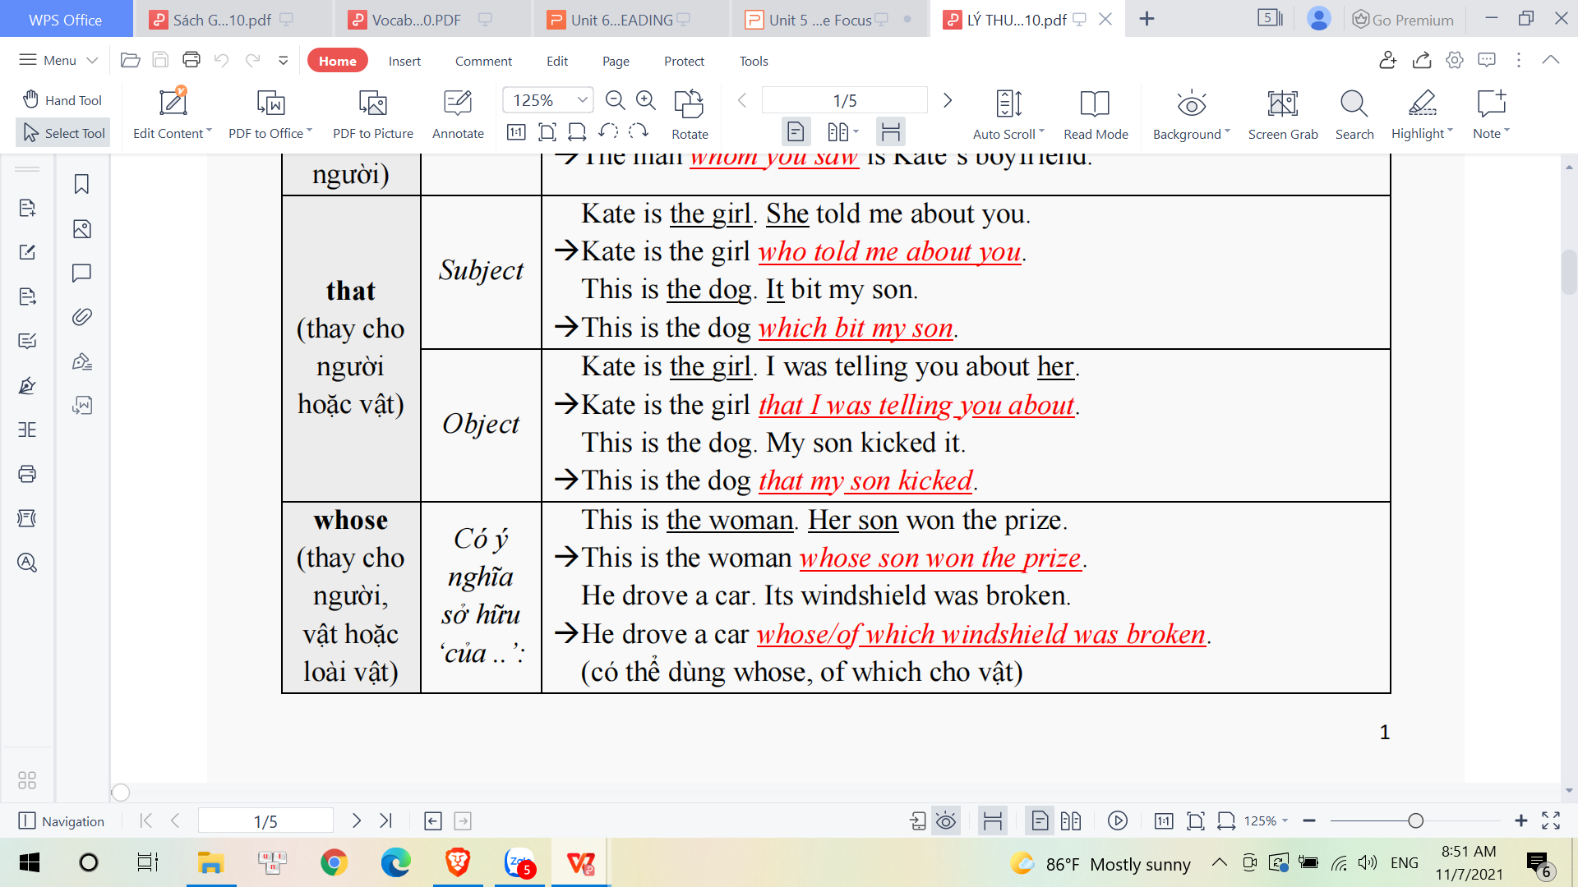
that
that

Slide 23
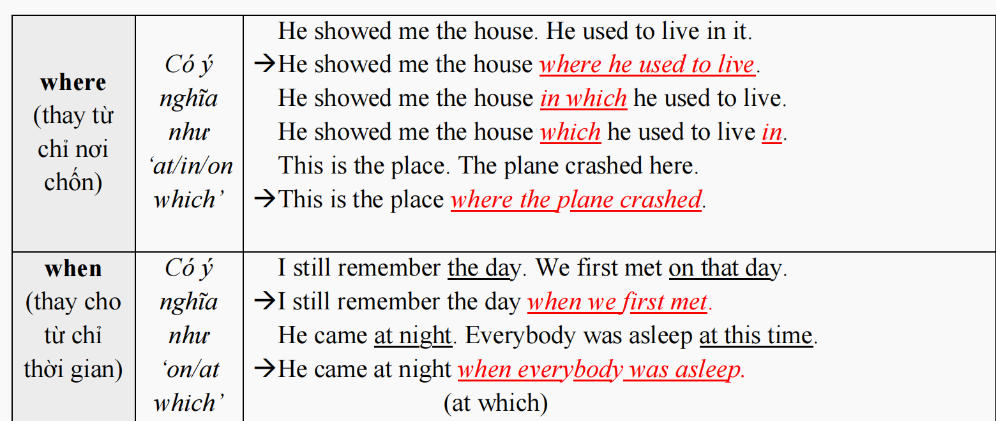

Slide 24
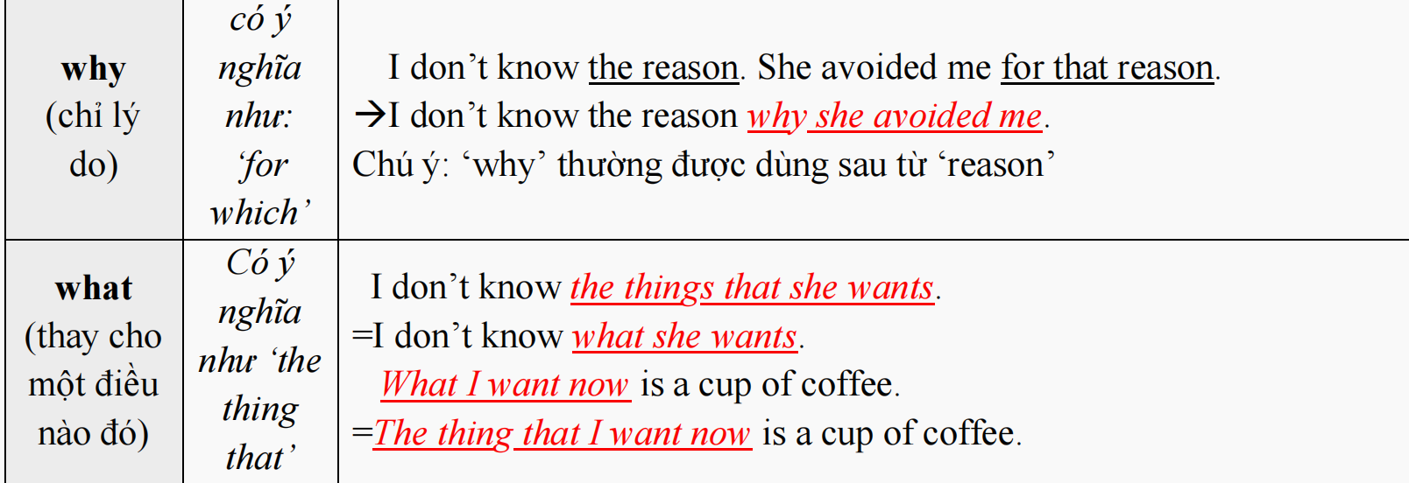

Slide 25
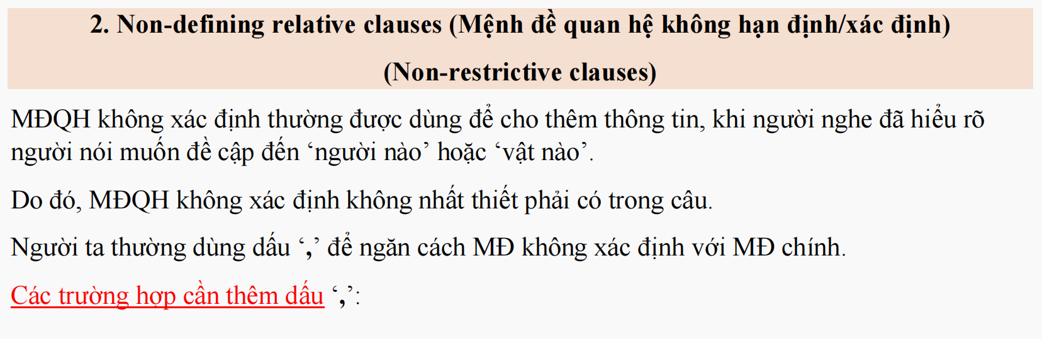
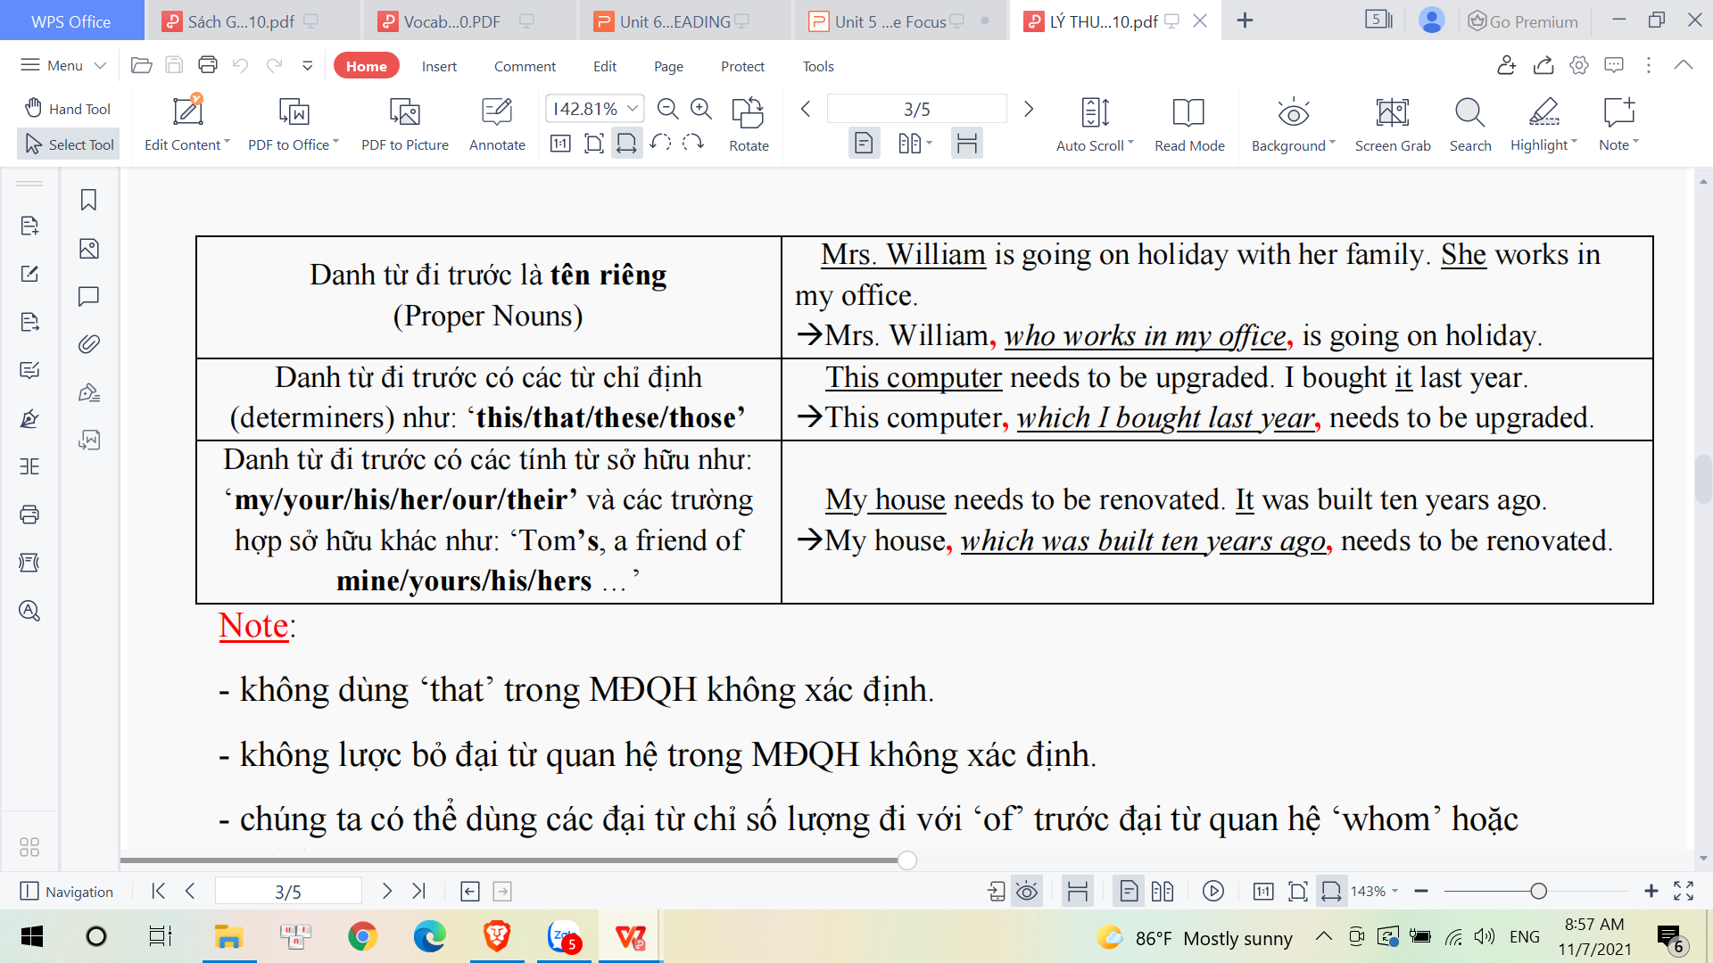

Slide 26

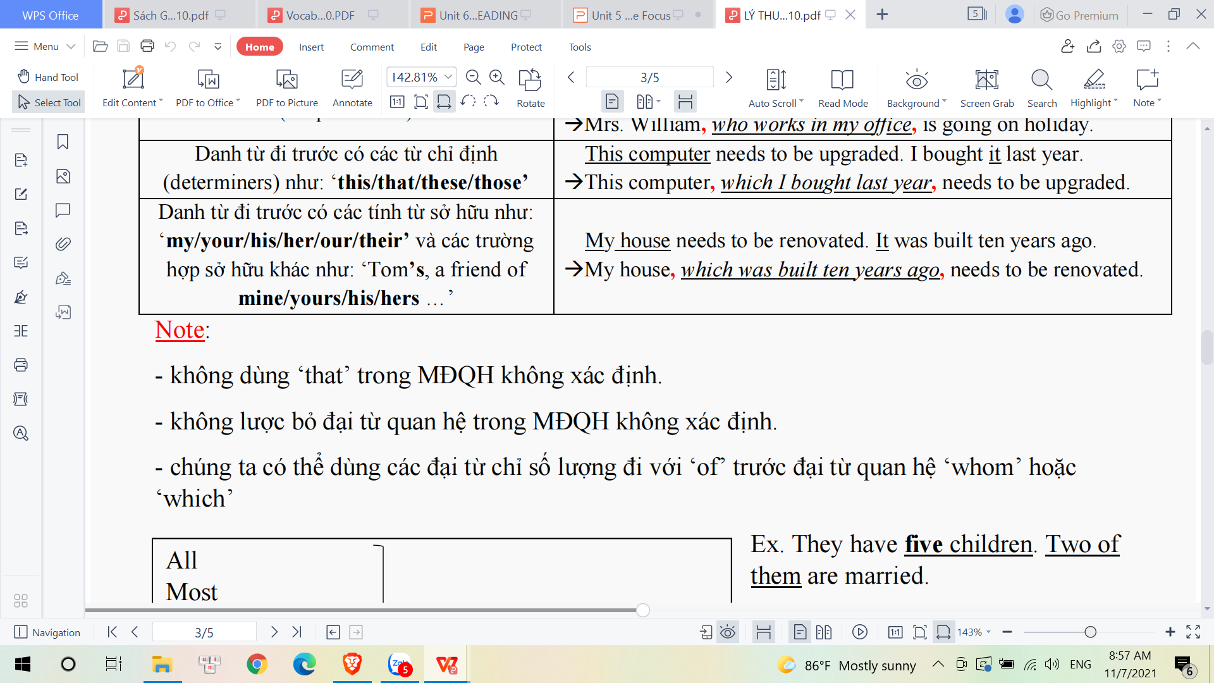

Slide 27
Exercise 3: FILL IN THE BLANK WITH: WHO, WHICH AND THAT
which
A clock is an instrument tells you the time.
2.A fridge is a machine is used for keeping food fresh.
3. April 1st is the day is called April Fool’s Day in the West.
4. A nurse is a person looks after patient.
5. A teacher is a person gives lesson to students.
6. A blind person is the one can’t see anything.
7. The man you visited last month is a famous scientist.
8. Please think of a word comes from a foreign language into Vietnamese.
9. These are the pictures my son drew when he was young.
10. Can you help me find the man saved the girl?
which
which
who
who
who
who(m)
which
which
who

Slide 28
Complete the following sentences:
“ Diana is a wonderful dancer.
“ She how to dance since she was four”.
A. Has been teaching B. has been taught
C. Is teaching D. was taught
2. They in Myhiepson for 12 years.
A. have been lived B have lived
C. are living D. lived
B
B
B
Combine the sentences. Using relative clause
This is the magazine. I bought it yesterday.
The girl is called Helen. She lives next door.

Slide 29


THANKS FOR
YOUR ATTENTION

